Slide 1
Mastering Agile Scrum: Empowering Your Software Development Team

Slide 2
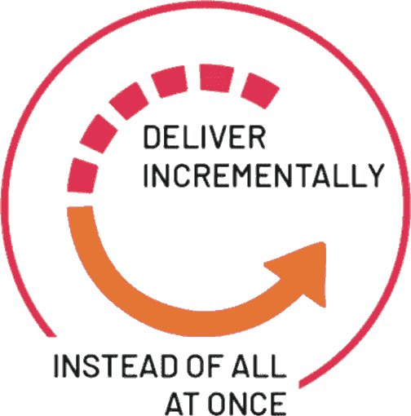


INTRODUCTION
Welcome to Mastering Agile Scrum, a professional guide to empower your software development team through agile methodologies. This presentation will provide valuable insights and practical tips to optimize your team's performance.

Slide 3
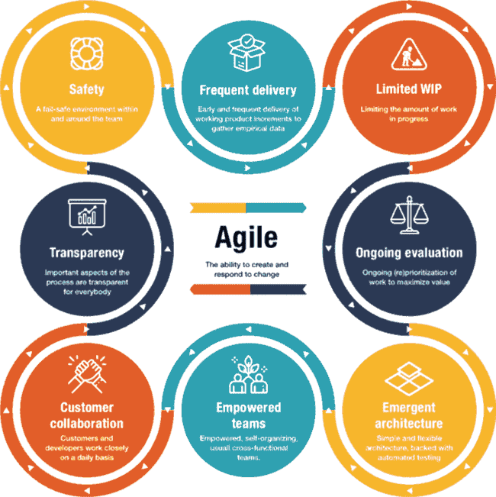
Understanding Agile
Agile is a flexible, iterative approach to software development that emphasizes adaptability and customer collaboration. It enables teams to respond to changes quickly and deliver high-quality products efficiently.

Slide 4









Agile Execution Methodologies
Methodology
Suitable For
Known For
Scrum
Small teams, Cross-team collaboration.
Scrum roles, Sprints, Agile events
Kanban
Advanced Agile teams, Frequently changing product requirements.
Kanban board, Continuous workflow
Scrumban
Fast-paced environment, Developing multiple products
Scrumban board, 3-month,6-month & 1-year buckets
Extreme Programming
Same location, Mixed-skill level teams, Smaller budgets.
Test-driven development, Pair programming, Simple design, Collective code ownership.
Lean
Small, empowered teams that make their own decisions.
MVP, Eliminating redundant activities.
Crystal
Different team sizes, Advanced teams in Agile, Less involvement from the higher management.
Crystal Clear, Crystal Yellow, Crystal Orange, Crystal Orange Web, Crystal Red, Crystal Maroon, Crystal Diamond, and Crystal Sapphire.
DSDM
Frequently changing requirements, Corporate environment.
Fixed cost, fixed time schedule, negotiable features, MoSCoW prioritization techniques.
FDD
Large-scale software projects, Finance and banking industry.
Making progress on features, 5-step development process flow.
ASD
Timely delivery, Continuously updated, offering Complex software projects.
Three phases: speculate, collaborate, and learn, Early delivery, Frequent testing.

Slide 5
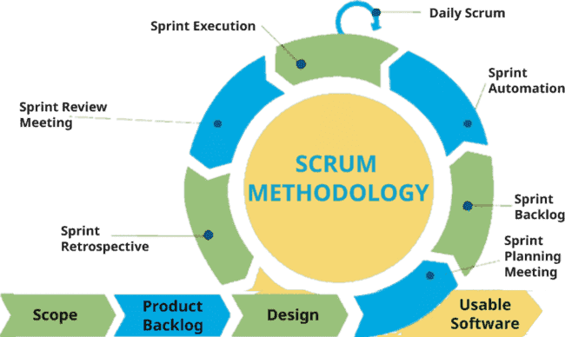
Scrum Framework
Scrum is a popular framework for implementing agile principles. It promotes transparency, inspection, and adaptation, allowing teams to deliver value in short cycles known as sprints.

Slide 6

Empowering Teams
Empowering your software development team with Agile Scrum involves fostering a culture of collaboration, self-organization, and continuous improvement. This approach enhances team productivity and innovation.
Managing the Work
Individuals sign up for work of their own choosing
Work is never assigned
Estimated work remaining is updated daily
Any team member can add, delete or change the sprint backlog
Work for the sprint emerges
If work is unclear, define a sprint backlog item with a larger amount of time and break it down later
Update work remaining as more becomes known

Slide 7

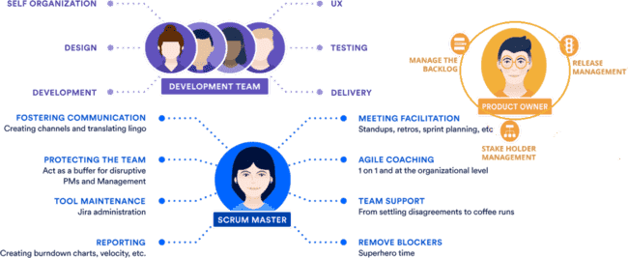
Roles in Scrum
Key roles in Scrum include the Product Owner, Scrum Master, and Development Team. Each
role plays a crucial part in ensuring alignment and delivery of valuable software.

Slide 8







Roles in Scrum
Product owner
Define the features of the product
Makes scope vs. schedule decisions
Responsible for achieving financial goals of the project
Prioritize the product backlog
Adjust features and priority every sprint, as needed
Accept or reject work results
The ScrumMaster
Responsible for enacting Scrum values and practices
Removes impediments
Coaches the team to their best possible performance
Helps improve team productivity in any way possible
Enable close cooperation across all roles and functions
Shield the team from external interference
The Team
Typically 5-9 people
Cross-functional:
Programmers, testers, user experience designers, etc.
Members should be full-time
May be exceptions (e.g., database administrator)
Teams are self-organizing
Ideally, no titles but rarely a possibility
Membership should change only between sprints

Slide 9







Artifacts in Scrum
Scrum artifacts, including the Product Backlog, Sprint Backlog, and Increment provide transparency and visibility into the work being done, ensuring that the team is aligned and focused on delivering value.
Roles
Product owner
ScrumMaster
Team
Ceremonies
Sprint planning
Sprint review
Sprint retrospective
Daily scrum meeting
Artifacts
Product backlog
Sprint backlog
Burndown charts
Risk Register

Slide 10
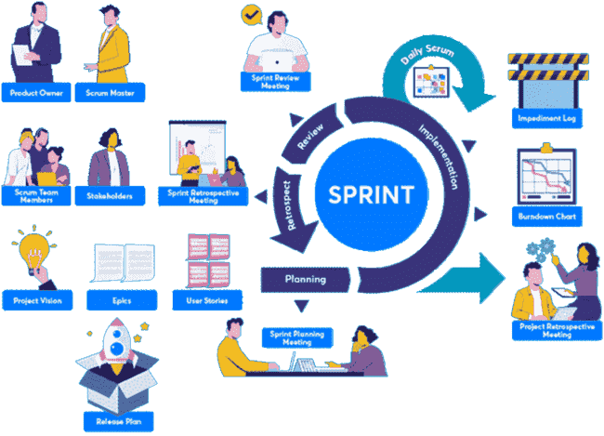
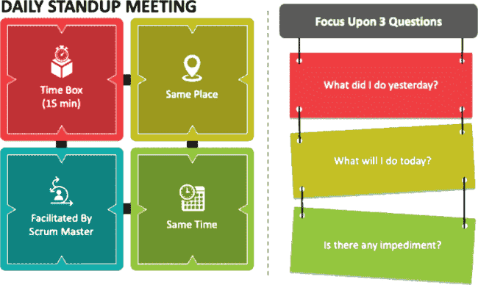
Scrum Events
Scrum events such as Sprint Planning, Daily Stand-ups, Sprint Review, and Sprint Retrospective facilitate effective communication and collaboration within the team, driving continuous improvement.

Slide 11
Sprint Planning
we need to take to complement the Agile Transformation - 3 Sprint Ahead of Functional Specification
Sprint 0
Sprint 1
Sprint 2
Sprint 3
Planning after Sprint 1 gathering completed
data gathering for Sprint 2 features
design for Sprint 1 features – high technical requirements, low user requirements
gather user input for Sprint 3 features
design Sprint 2 features
support Sprint 1 development and
testing
gather user input for Sprint 4 features
design Sprint 3 features
support Sprint 2 development and testing
Automate Sprint 1 features verifications
gather user input for Sprint 5 features
design Sprint 4 features
support Sprint 3 development and testing
Automate Sprint 2 features verifications
Product Owner Team
feature design
+ bugs found in
Integration or automation testing
support dev
coded features
support dev
feature design
Development and Testing Team
development environment setup
architectural “spikes”
implement Sprint 1 features
implement Sprint 2 features
fix Sprint 1 bugs if any
implement Sprint 3 features
fix Sprint 2 bugs if any
time

Slide 12
Sprint Schedule
Activities in typical sprint
Daily Standup
Daily Standup

Slide 13
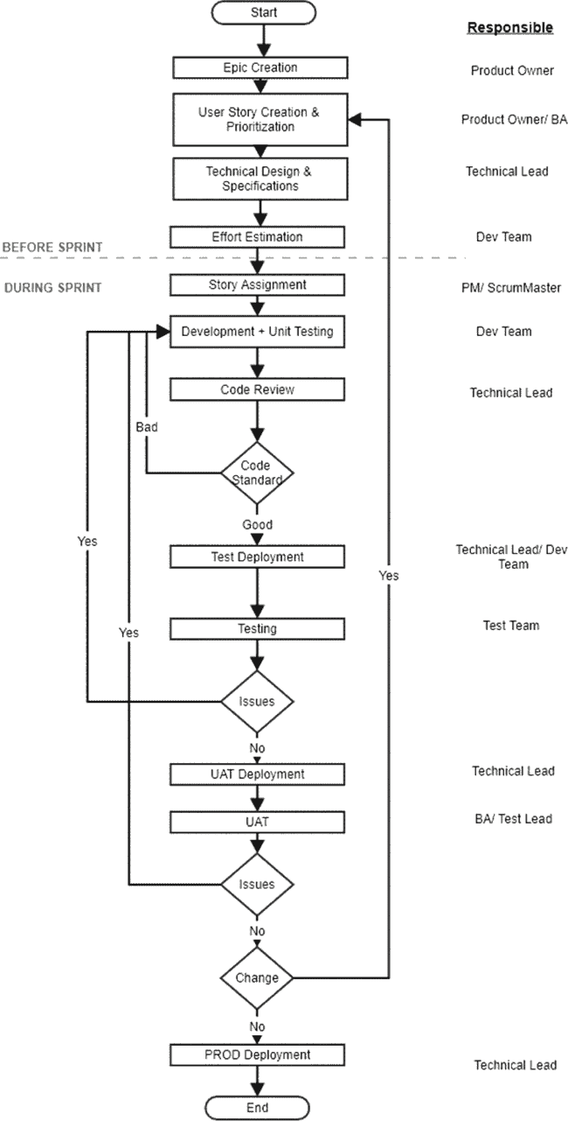
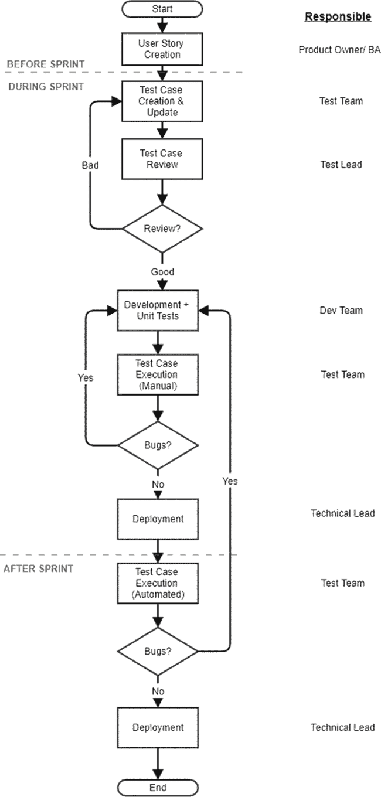
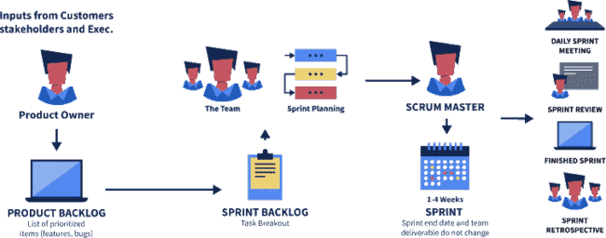
Sprint Structure
Roles and Activities in typical sprint

Slide 14


Sprint Review (Demo)
Team presents what it accomplished during the sprint
Typically takes the form of a demo of new features or underlying architecture
Informal
2-hour prep time rule
No slides
Whole team participates
Invite the world

Slide 15








Continuous Improvement
Embracing a culture of continuous improvement is essential in Agile Scrum. Encouraging feedback loops and implementing retrospective practices enables teams to identify areas for enhancement and drive innovation.
Sprint retrospective
Start / Stop / Continue
Whole team gathers and discusses what they’d like to:
Start doing
Stop doing
Periodically take a look at what is and is not working
Typically around 30 minutes
Done after every sprint
Whole team participates
ScrumMaster
Product owner
Team
Possibly customers and others
This is just one of many ways to do a sprint retrospective.
Continue doing

Slide 16

Measuring Success
Measuring success in Agile Scrum involves tracking key metrics such as velocity, burndown charts, and quality metrics to evaluate the team’s performance and delivery of value.

Slide 17
Scaling Agile
Scaling Agile practices involves leveraging frameworks such as SAFe (Scaled Agile Framework) and LeSS (Large-Scale Scrum) to extend agile principles across large organizations and complex projects.
Which One? | SAFe | SoS | DAD | LeSS
Based on | Agile Values | Scrum | Various Agile techniques | Scrum
Company Size | Large organization to enterprises | Several Scrum Teams | Midsized Organizations | Midsized Organizations
Company Level Definition | Defines Communication all the up to executive floor | Defines Communication between Teams | Define Communication between different teams and departments | Define Communication between different teams and management
Routines | Scrum, Kanban and custom routines | Scrum routines with Scrum of Scrums | Scrum, Kanban and custom routines | Scrum routines with additional meetings
Cost To Implement | High, requires restructuring and change of process | Low, natural progression of Scrum | Medium, requires change of process | Low, natural progression of Scrum
Method | Tasks
Kanban | Initiation - POC, Discovery - Research to EPIC, EPIC to Technical Solution, Retrospective Actions
Scrum | Delivery - Development and Testing
XP | Initiation - Ux / Cx, Discovery, Delivery - Ux / Cx, Estimation, Release - Deployment and Release Management

Slide 18
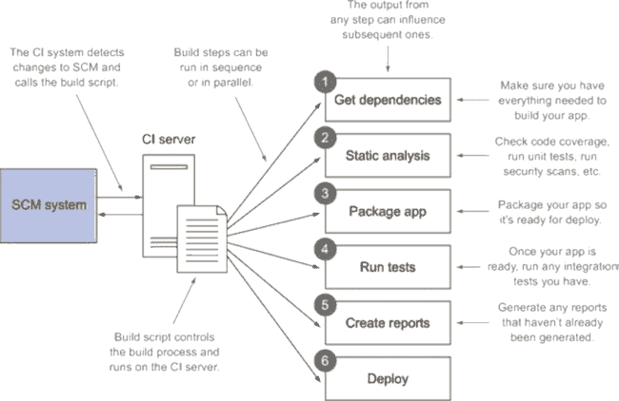

BEST PRACTICES
Implementing best practices such as cross-functional teams, clear communication, and prioritizing customer value are essential for maximizing the benefits of Agile Scrum and empowering your software development team.

Slide 19



CONCLUSION
In conclusion, mastering Agile Scrum empowers software development teams to deliver value with agility and quality. Embracing the principles of Agile Scrum fosters a culture of innovation, collaboration, and continuous improvement.
Struggle
Support
Optimize
Expand
Transform

Slide 20
Weekly Report - <<Customer Name >>
Tuesday, 12 March 2024

Slide 21


Current Status
Over All | Budget | Scope | Resources | Timeline | Quality | Risks
ON
ON
ON
ON
ON
OVER
OVER
First Half Code Merge and Integration
Second Half Code Merge and Integration
Access Grand
Environment Setup
UAT and Support
IMPL Env Merging
PROJECT START DATE
01/Feb/2024
CURRENT TIMELINE POSITION
01/Mar/2024
RISKS AND ROADBLOCK 1
Access Delayed by 2 days
Port Exposure delayed by 1 day
Build Script
Jenkin Access yet to be provided
Due to build delay QA activities not started
PROJECT END DATE
14/Mar/2024
RISKS AND ROADBLOCK 4
Details
RISKS AND ROADBLOCK 2
Angular UI build was failed on 2 days delayed testing
Changes checked in and Action ID mapping not reflecting on 23 Feb 2023
RISKS AND ROADBLOCK 3
IMPL or Test environment yet to be finalized

Slide 22


Sprint Goals
Outline the main objectives and goals set for the sprint.

Slide 23
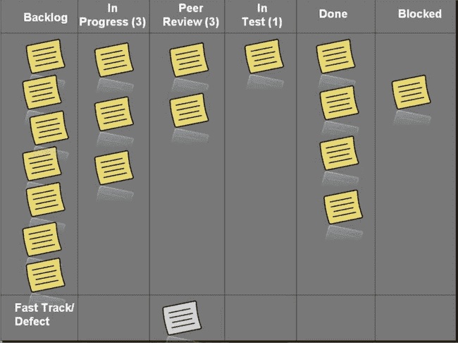

Sprint Progress Overview
Provide a brief overview of the progress made during the week.
Highlight incremental progress of completed tasks, user stories, or features.

Slide 24


Backlog Status
Tasks Status:
Update on the status of the backlog items.
Identify any new items added or removed.
Issues and Challenges:
Discuss any impediments or challenges faced during the week.
Include details on how these challenges were addressed or mitigated.

Slide 25

Team Contributions
Recognize individual and team contributions.
Mention any achievements or outstanding efforts.

Slide 26
Testing and QA
Summarize the testing activities conducted during the week.
Note any bugs or issues identified and their resolutions.
ID | Description | Potential Impact | Priority | Date Opened | Date Closed | Issue Owner | Department | Status | Notes
1 | Website loading slowly on ie10 | 5% of visitors may experience lag | Critical | 05-Apr |  | Dale | IT | Open | For whenever Dale has free time
2 | Website crashing at credit card collection screen | Massive loss of revenue | Low | 09-Apr |  | Julie | IT | Open | Need to send report to C-suite on this
3 | Serving old format images | poor SEO results | Medium | 25-Mar |  | Sarah | SEO | Open | See Google's reccomendartions
4 | Login icons broken on Homepage | Some users unable to login w/ icons | High | 03-Apr | 09-Apr | Julie | IT | Closed | Completed 4/6/20

Slide 27
Velocity and Burndown
Display the velocity of the team.
Include a burndown chart to visually represent progress.
 | INITIAL ESTIMATE | WEEKS |  |  |  |  |  |  |  | HOURS REMAINING
FEATURE |  | 1 | 2 | 3 | 4 | 5 | 6 | 7 | 8
Categories | 80 | 15 | 12 | 7 | 5 | 10 | 16 | 14 | 1 | 0
Synchronization | 80 | 12 | 8 | 5 | 7 | 9 | 6 | 11 | 12 | 10
Accounts | 80 | 9 | 8 | 7 | 6 | 5 | 7 | 9 | 11 | 18
Reminders | 80 | 13 | 9 | 7 | 5 | 4 | 6 | 8 | 12 | 16
 |  | WEEKS |  |  |  |  |  |  |  | CHART ID
SETTING | START | 1 | 2 | 3 | 4 | 5 | 6 | 7 | 8
Planned Hours |  | 40 | 40 | 40 | 40 | 40 | 40 | 40 | 40
Actual Hours |  | 49 | 37 | 26 | 23 | 28 | 35 | 42 | 36
Remaining Effort | 320 | 271 | 234 | 208 | 185 | 157 | 122 | 80 | 44
Ideal Burndown | 320 | 280 | 240 | 200 | 160 | 120 | 80 | 40 | 0

Slide 28
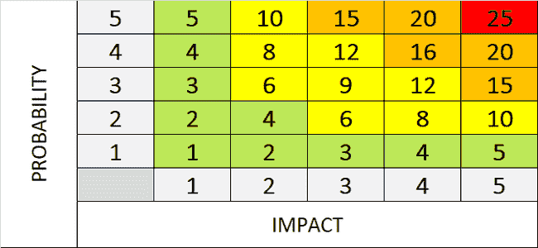
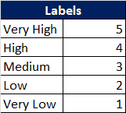
Risk Chart
Present an updated risk chart outlining potential risks and their current status.
Include any new risks identified during the week.
PROJECT NAME |  | CLIENT NAME
PROJECT MANAGER |  | Sunil Kumar Dash
PROJECT METHOD |  | Waterfall
Document Type: |  | RISK Register
Risk ID | Date Raised | Risk Originator(Raised By) | Risk Description | Risk Category | Probability | Impact | Severity | Risk Response | Trigger | Risk Owner | Action Owner | Mitigation Plan | Contingency Plan | Action Due Date | Status | Notes
1 | 01-01-2023 | Sunil Kumar Dash | Risk: Integration Challenges: Difficulty in integrating various software components, resulting in delays or functionality issues. | Technical (Network,IT) | 4 | 4 | 16 | Mitigation | Lack of proper communication between development teams. | Michael Jordan | Michael Jordan | Implement a comprehensive integration testing strategy and conduct regular code reviews. | Allocate additional time and resources for integration-related tasks. | 10-01-2023 | Assessed | Conduct thorough testing and prototyping during the development process.
2 | 02-01-2023 | Sunil Kumar Dash | Risk: Security Vulnerabilities Potential security breaches and data leaks, leading to compromised user information. | Internal | 5 | 5 | 25 | Mitigation | Weaknesses in the application's architecture or inadequate security measures. | Sagar Mehta | Sagar Mehta | Conduct thorough security testing and apply necessary patches and updates promptly. | Have a rapid response plan in place to mitigate and recover from any security breaches. | 10-01-2023 | Assessed | Implement robust security measures, including encryption, secure coding practices, and regular security audits.
3 | 03-01-2023 | Sunil Kumar Dash | Risk: Scope Creep Continuous expansion of project scope beyond the initial requirements, leading to delays and resource constraints. | Internal | 5 | 4 | 20 | Mitigation | Frequent changes in client requirements or poor scope management. | Viktor | Viktor | Regularly communicate and align with stakeholders to ensure scope adherence. | Allocate additional resources or adjust project timelines to accommodate scope changes. | 15-01-2023 | Assessed | Clearly define and document project scope. Implement a change control process to manage scope changes effectively.
4 | 04-01-2023 | Sagar Kumar | Risk: Integration Challenges: Difficulty in integrating various software components, resulting in delays or functionality issues. | Technical (Network,IT) | 4 | 4 | 16 | Mitigation | Lack of proper communication between development teams. | Michael Jordan | Michael Jordan | Implement a comprehensive integration testing strategy and conduct regular code reviews. | Allocate additional time and resources for integration-related tasks. | 10-01-2023 | Assessed | Conduct thorough testing and prototyping during the development process.
5 | 05-01-2023 | Sagar Kumar | Risk: Security Vulnerabilities Potential security breaches and data leaks, leading to compromised user information. | Internal | 5 | 5 | 25 | Mitigation | Weaknesses in the application's architecture or inadequate security measures. | Sagar Mehta | Sagar Mehta | Conduct thorough security testing and apply necessary patches and updates promptly. | Have a rapid response plan in place to mitigate and recover from any security breaches. | 10-01-2023 | Assessed | Implement robust security measures, including encryption, secure coding practices, and regular security audits.
6 | 06-01-2023 | Sumant Mehta | Risk: Scope Creep Continuous expansion of project scope beyond the initial requirements, leading to delays and resource constraints. | Internal | 5 | 4 | 20 | Mitigation | Frequent changes in client requirements or poor scope management. | Viktor | Viktor | Regularly communicate and align with stakeholders to ensure scope adherence. | Allocate additional resources or adjust project timelines to accommodate scope changes. | 15-01-2023 | Assessed | Clearly define and document project scope. Implement a change control process to manage scope changes effectively.
7 | 07-01-2023 | Sumant Mehta | Risk: Integration Challenges: Difficulty in integrating various software components, resulting in delays or functionality issues. | Technical (Network,IT) | 4 | 4 | 16 | Mitigation | Lack of proper communication between development teams. | Michael Jordan | Michael Jordan | Implement a comprehensive integration testing strategy and conduct regular code reviews. | Allocate additional time and resources for integration-related tasks. | 10-01-2023 | Assessed | Conduct thorough testing and prototyping during the development process.
8 | 08-01-2023 | Sunil Kumar Dash | Risk: Security Vulnerabilities Potential security breaches and data leaks, leading to compromised user information. | Internal | 5 | 5 | 25 | Mitigation | Weaknesses in the application's architecture or inadequate security measures. | Sagar Mehta | Sagar Mehta | Conduct thorough security testing and apply necessary patches and updates promptly. | Have a rapid response plan in place to mitigate and recover from any security breaches. | 10-01-2023 | Assessed | Implement robust security measures, including encryption, secure coding practices, and regular security audits.
9 | 09-01-2023 | Sunil Kumar Dash | Risk: Scope Creep Continuous expansion of project scope beyond the initial requirements, leading to delays and resource constraints. | Internal | 5 | 4 | 20 | Mitigation | Frequent changes in client requirements or poor scope management. | Viktor | Viktor | Regularly communicate and align with stakeholders to ensure scope adherence. | Allocate additional resources or adjust project timelines to accommodate scope changes. | 15-01-2023 | Assessed | Clearly define and document project scope. Implement a change control process to manage scope changes effectively.
10 | 10-01-2023 | Sunidhi Sharma | Risk: Integration Challenges: Difficulty in integrating various software components, resulting in delays or functionality issues. | Technical (Network,IT) | 4 | 4 | 16 | Mitigation | Lack of proper communication between development teams. | Michael Jordan | Michael Jordan | Implement a comprehensive integration testing strategy and conduct regular code reviews. | Allocate additional time and resources for integration-related tasks. | 10-01-2023 | Assessed | Conduct thorough testing and prototyping during the development process.

Slide 29

Upcoming Tasks
PROJECT NAME | FINISH | BEGIN
Dev Code Merging First Set | 09-02-24 | 01-02-24
Actuals | 09-02-24 | 04-02-24
Environment Setup | 02-02-24 | 01-02-24
Actuals | 05-02-24 | 04-02-24
stock order type | 02-02-24 | 01-02-24
Actuals | 06-02-24 | 05-02-24
communication provider | 02-02-24 | 01-02-24
Actuals | 06-02-24 | 05-02-24
communication template | 05-02-24 | 04-02-24
Actuals | 07-02-24 | 06-02-24
node to node relation | 05-02-24 | 04-02-24
Actuals | 07-02-24 | 06-02-24
stock transfer | 09-02-24 | 05-02-24
Actuals | 09-02-24 | 06-02-24
digital receipt setup | 09-02-24 | 05-02-24
Actuals | 09-02-24 | 06-02-24
upload download history | 09-02-24 | 05-02-24
Actuals | 09-02-24 | 06-02-24
First Set Testing | 16-02-24 | 11-02-24
Actuals | 16-02-24 | 11-02-24
stock order type | 12-02-24 | 11-02-24
Actuals | 12-02-24 | 11-02-24
communication provider | 12-02-24 | 11-02-24
Actuals | 12-02-24 | 11-02-24
communication template | 13-02-24 | 12-02-24
Actuals | 13-02-24 | 12-02-24
node to node relation | 13-02-24 | 12-02-24
Actuals | 13-02-24 | 12-02-24
stock transfer | 15-02-24 | 13-02-24
Actuals | 15-02-24 | 13-02-24
digital receipt setup | 16-02-24 | 14-02-24
Actuals | 16-02-24 | 14-02-24
upload download history | 16-02-24 | 14-02-24
Actuals | 16-02-24 | 14-02-24
List the tasks that will be worked on in the upcoming week.
Provide estimates or timelines for these tasks.

Slide 30
HIGHLIGHTS AND TAKE AWAYS
Things that worked well
Support from Kiran, Priya, Mansi, Nishita and Shashi
WhatsApp communication
Things that we collectively need to improve
Points that need immediate action
Finalization of IMPL environment

Slide 31

Client/Stakeholder Updates
Communicate any relevant information or updates to clients or stakeholders.
Include feedback received, if any.
Embrace the Kaizen philosophy: encourage small, incremental changes to achieve continuous improvement in the Scrum process

Slide 32
Sprint Report - <<Customer Name >>
Tuesday, 12 March 2024

Slide 33

Achievements
Highlight the major accomplishments over the three weeks.
Identify completed user stories, features, or milestones.

Slide 34
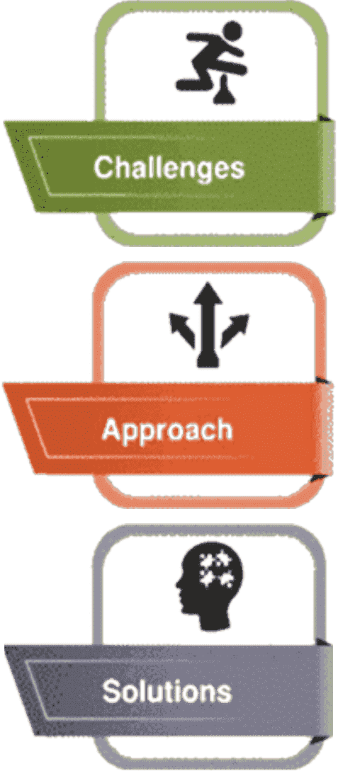

Challenges and Solutions
Summarize the challenges faced throughout the sprint.
Discuss the solutions implemented to overcome these challenges.

Slide 35

Sprint Retrospective Insights
Share key takeaways from the sprint retrospective.
Discuss improvements identified during the retrospective meeting.

Slide 36
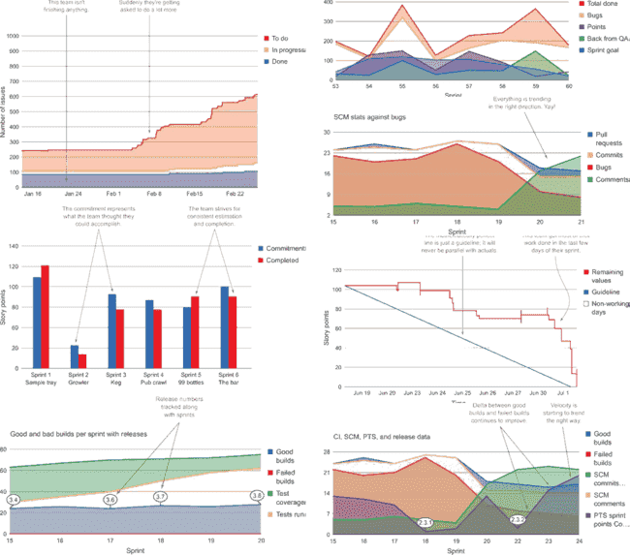
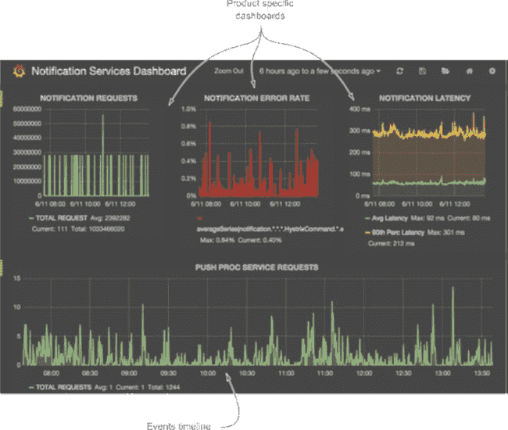
Metrics and Trends
Provide an overview of metrics such as velocity, burndown rate, and team performance.
Identify any patterns or trends observed over the three weeks.

Slide 37
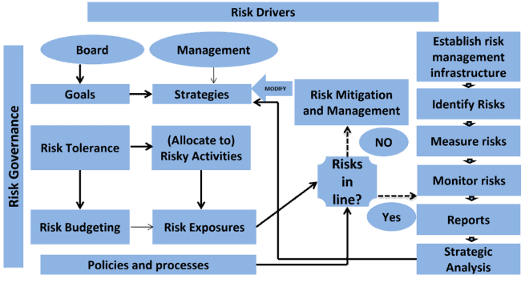
Risk Management Overview
Provide an updated overview of the risk chart, highlighting any changes or new risks.

Slide 38

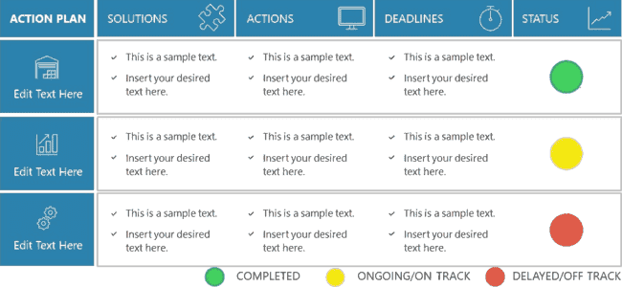
Next Steps
List the tasks that will be worked on in the upcoming week.
Provide estimates or timelines for these tasks.

Slide 39

Thanks!
ANY QUESTIONS?
Lakshmanaraj.sankaralingam@ideastoimpacts.com
+91 9225518035
https://www.linkedin.com/in/lakshmanarajsankaralingam/

